Slide 1


DNL 101:
A Tale of Uncommon Sense
Glen Bradford

Slide 2
Time ≠ Money
….Because Educational Systems Hardwire us to work for money

Slide 3
To him who has ears, let him hear
I can’t help you if you can’t help yourself.

Slide 4
This is like heroine
Once you taste it – you’ll never look at things the same again.
Financial advice favors self preservation over self expansion.

Slide 5
Choose your decimal point
0001000000
How many jobs did you apply for?
How many people do you want to meet this year?
What is worth fighting for?
What is your time worth?

Slide 6
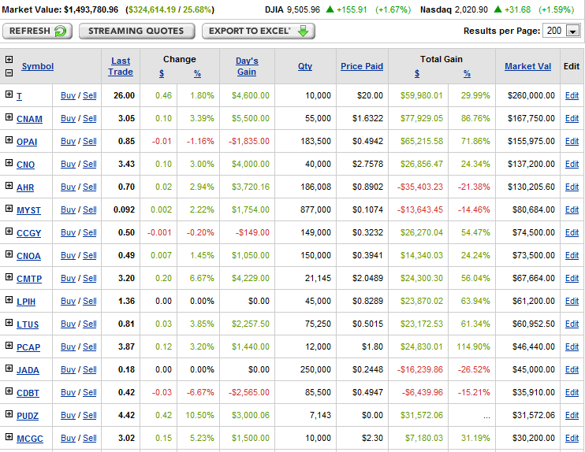
Can you see what I see?

Slide 7
Throw out some stock picks
Let’s play a game, you name a stock, I name a better one. Begin.
Now, play that game by yourself and go through 1000 repetitions and you’re left with… 10 of the best stocks.
Anyone want to consolidate stock picks?

Slide 8
The Goal of this Class
The goal of this class is to give you the mental framework that no MBA school will give you, a mental framework that will consistently keep you from losing money in the stock market over long periods of time.
Teach you how to put your money where other money is headed, before it gets there
Ask me about MBA schools in Incentives…

Slide 9
The Golden Assumption
Companies that make more money and are set to make more money than other companies should be more expensive than other companies.
If A makes more than B and
If A is growing faster than B
THEN A should be more expensive than B

Slide 10
What is Recommended for this “Class”
Brain, Laptop, Headphones, Internet Access
This is not a class. I am not getting paid. I don’t really expect you to be able to beat the market, and I realize the best that I can do is give you the opportunity and the incentive to take it. The choice to take it is yours, and yours alone. This is meant to be fun.

Slide 11
Timeline
12 Weeks, Once a Week, 55 Minutes
You have a question? Ask. If I can’t answer it, Maybe someone else can.
Basically, I can only talk so long, I’ll come up with some good material, but other than that, it’s really up to you to ask via trial and error what’s going on.

Slide 12
Break out the Disclaimers
There are 3 steps that you need to be able to do in order to be successful. If you can’t do them. I suggest you give up now.
I have a tendency to say things that may make you throw up in your mouth a little bit. I find that by taking opposite extreme points of view and compromising, you make progress.

Slide 13
Step 1. Believe in Yourself
If you don’t believe that you can beat the market, this class is not for you.

Slide 14
Step 2. Question Everything
If you want to blindly believe what others tell you, this class is not for you.
EMH, Witch Hunts, Anticipate vs. achieve, Reading Tea Leaves, Polar Bear Club, LAMB Club, Suicide, Technical Analysis.
Incentives: Psychics? ANALysts? Mutual Fund Managers? Your Broker? Journalists? Your friends? MBA school?

Slide 15
Step 3. Take Action
If you’re going to sit around and philosophize and not do anything about your gut feelings, this class is not for you.
I’m not a “coulda-woulda-shoulda” kind of guy.
If it’s meant to be done, execute. No exceptions.
Only undertake “obvious deals”

Slide 16
Step 4. A Super Secret!
You don’t have to do anything. The stock market is like baseball, except you only get a strike if you swing and the pitcher is wasted. You might as well just wait for the right pitch, but you’re going to have to put in the time waiting and looking for the right pitch before it actually comes.
The best hitters don’t want to tell you how they do it.
Getting Beaned is like Debt, you take the base, but you don’t get any points.

Slide 17
You Win By:
Screwing up the least.
Not losing money.
Avoiding bad logic
Avoiding empty suits
Not being an idiot
Understanding overconfidence
Understanding correlation vs causation
Before you buy, ask yourself honestly how much you might LOSE over time

Slide 18
Focus: Relative Valuation
The absolute pricing of a company isn’t as important as how it is valued relative to the rest of the market and its peer group.
Thanks to opportunity cost, when you have two opportunities, when A gets cheaper, B has to get cheaper as well, as people shift out of B into A as it becomes a better deal.

Slide 19
Know what you own
Nobody gets this right. This does not mean buy stocks of companies you have stuff from. This means, to really understand how a company makes money, you need to understand their product and their market… because if the market goes bad, that changes the stock price.

Slide 20
Round 1: What do companies make?
Good Citizens?
Goods? Services?
Good Employees?
Money?
Currency! Companies make currency

Slide 21
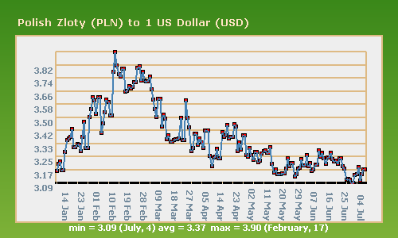

Slide 22
Round 2
Don’t reinvent the wheel.
Ben Graham: P/B
Warren Buffett: P/E
Peter Lynch: PEG
Ken Fisher: P/S

Slide 23
Round 3
Knockout
Start sorting through companies.
Here’s my story, here’s what I’ve learned.
Here’s what works.
Here’s what doesn’t work.

Slide 24
How the BIG MONEY is made
Build a mental framework that only lets in the best companies at great prices.
Find great companies at “OK” prices.
Wait for a market crash.
Wait for everyone to panic and then use your lists to find great companies at great prices.
BUY BUY BUY, wait for 5 years or until other people realize they are great companies.

Slide 25
Make money being a permabull!
When stocks are crashing, there will always be stocks crashing faster than yours, that are better than yours. Sell yours and buy the better deal once the selling panic is over on the better deal. Welcome to relative valuation.
Stay diversified until the last second, forecast how bad the market could get, potentially go on margin up to 50% safety at that worst point. Be realistic! If you don’t know, don’t do it!

Slide 26
Sure, why not, chase growth!
Find companies that are growing at accelerating rates when their prices are shrinking from “cheap” to “HOLY CRAP THIS IS CHEAP!”

Slide 27
Best defense is a good offense
Always seek to own better companies and if you find them, sell what you have and buy them instead. Make sure to understand the limitations of what you actually know and that in some cases, diversification makes sense and at other times it does not. If you are truly 110% confident in a 100% return in 1 year opportunity, go borrow as much as you can from everyone and invest.

Slide 28
People will lie to you
They might not even know that they are lying. They might just be spreading something from someone that they thought was telling the truth.

Slide 29
People will use you if you let them
Stand up for what you believe in, if standing up does not prevent you from achieving other goals that you seek that are of greater importance. In other words, there’s no need to fight many small battles and overlook the large battle.

Slide 30
Buffetology 101
3. Cheap Price
2. Future Growth
1. Highly Predictable

Slide 31
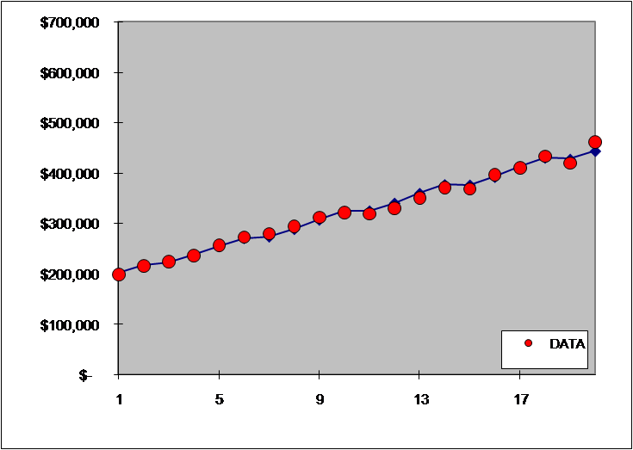
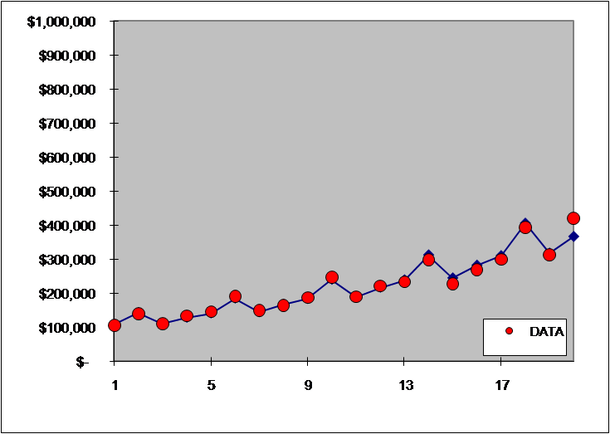
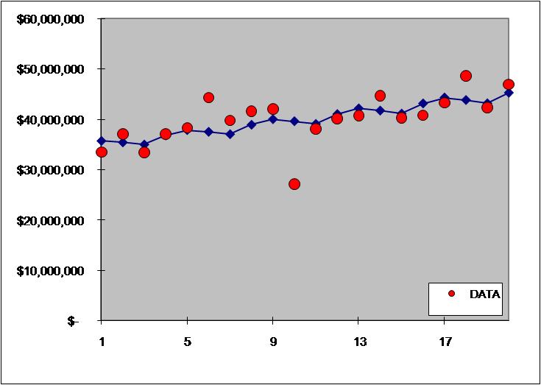
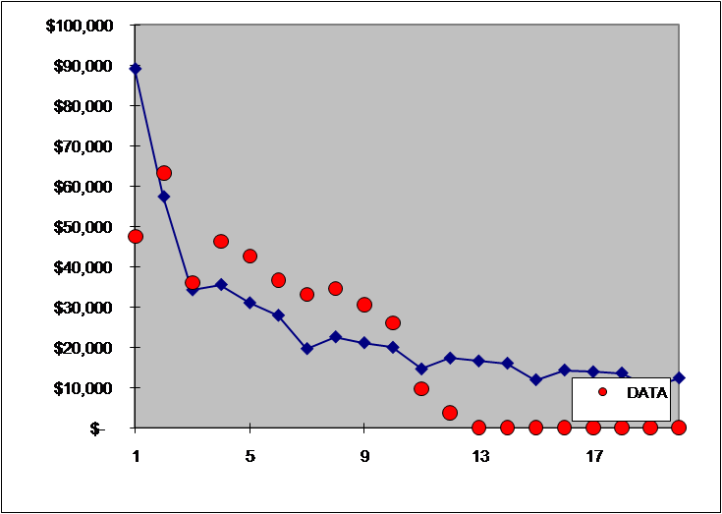
1. Highly Predictable
“Risk comes from not knowing what you're doing.” (Buffet)
.949
.992
.414
.394

Slide 32
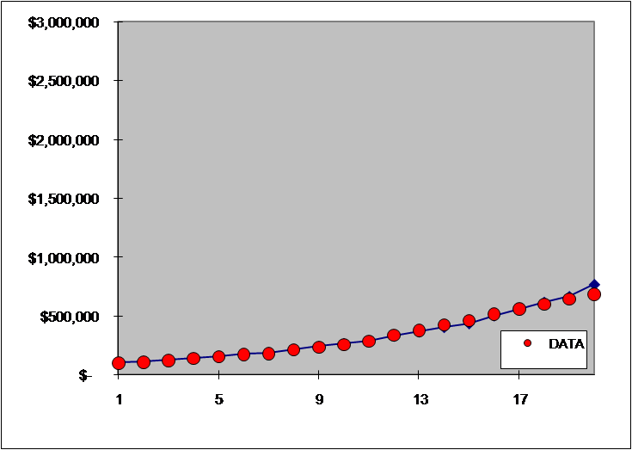
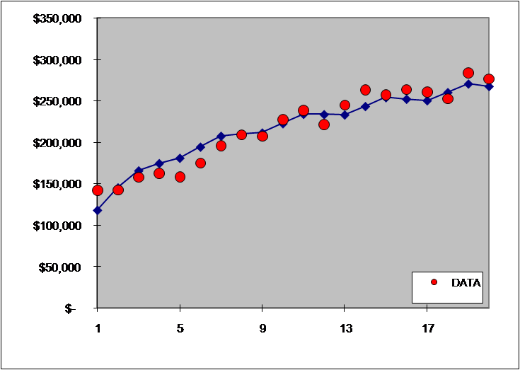
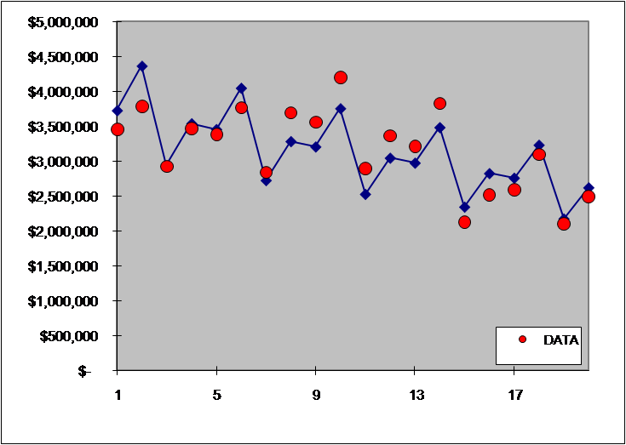
2. Future Growth
“The investor of today does not profit from yesterday's growth.” (Buffet)
.996
.904
.414
.613

Slide 33

3. Current Price
“Price is what you pay. Value is what you get.” (Buffett)
Growth Rate > PE Ratio
PEG Ratio < 1
Buffet: Discounted Cash Flow Analysis
Ben Graham Formula
www.glenbradford.com

Slide 34
Logic Structures (Glen Simplified)
Symptom | Concept | Remedy
Escalation of Commitment | Bounded Rationality | Situational Awareness
Defective Reasoning | Opportunity Cost | Basic Economics
Paralysis by Analysis | Overconfidence | Black Swan Logic

